Slide 1
Card Play in Slay the Spire Using Reinforcement Learning
Greyson Henry

Slide 2
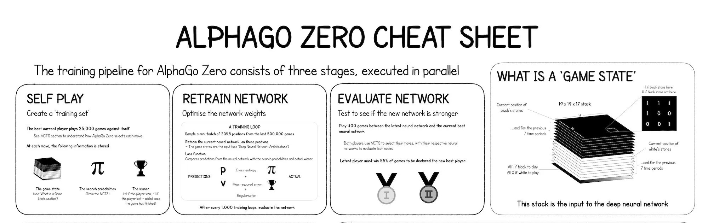
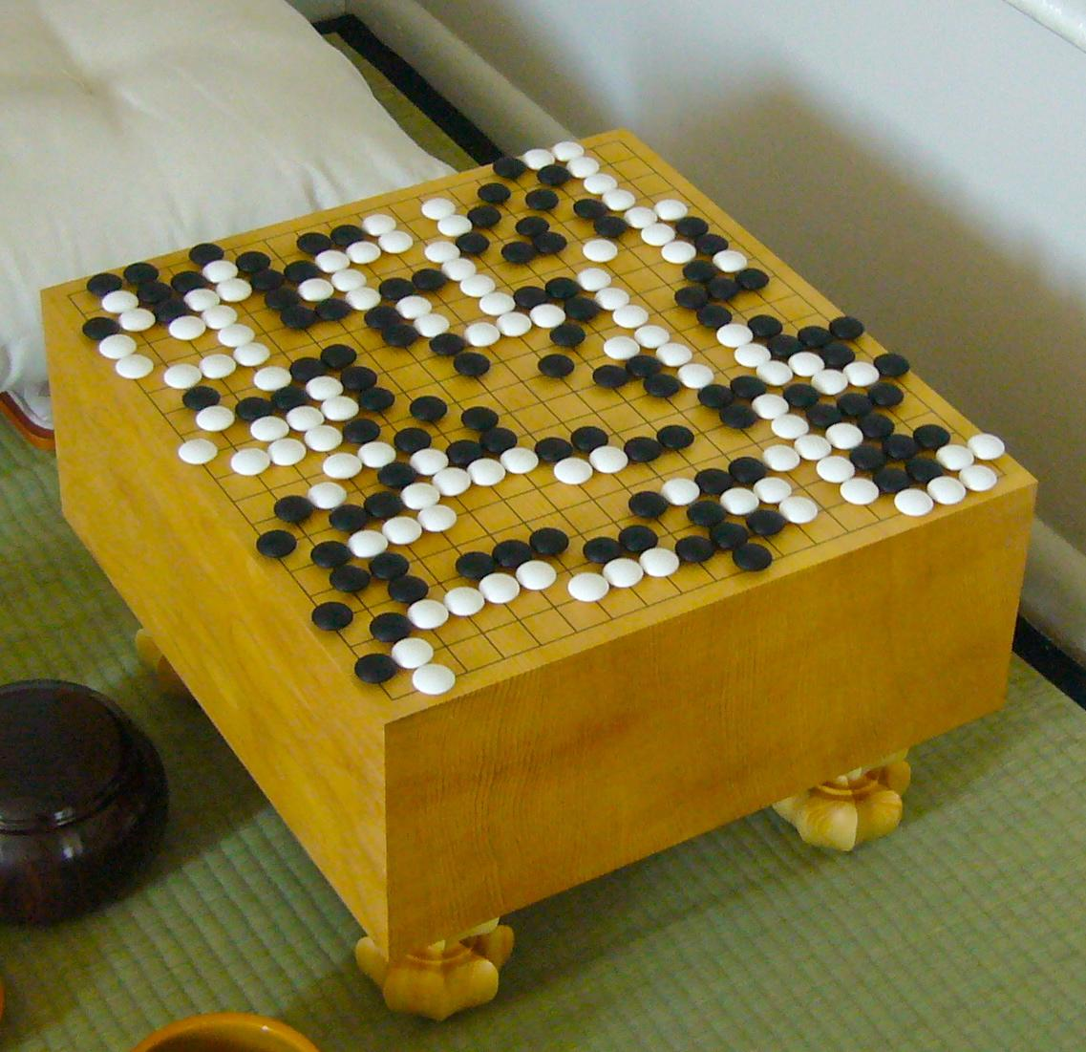
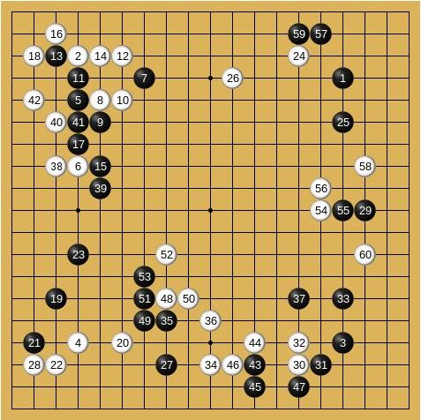
Motivation
Image: https://medium.com/applied-data-science/alphago-zero-explained-in-one-diagram-365f5abf67e0
Image: https://en.wikipedia.org/wiki/Go_(game)

Slide 3
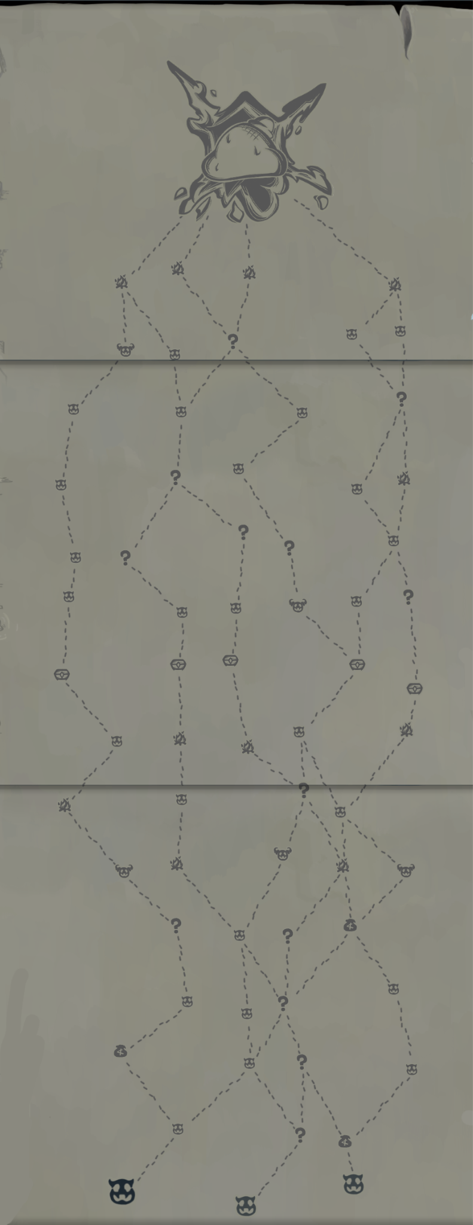

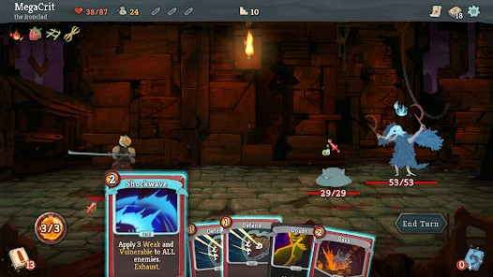

Slay the Spire Gameplay Processes & RL Fitness
Pathing | Drafting | Card Play | Menus
How do I decide between maximizing reward and minimizing risk? | Which cards do I take? | Which cards do I play? In what order? | Which option do I select? How much money do I save?

Slide 4
Slay the Spire Gameplay Processes & RL Fitness
Pathing | Drafting | Card Play | Menus
How do I decide between maximizing reward and minimizing risk? | Which cards do I take? | Which cards do I play? In what order? | Which option do I select? How much money do I save?
Too long + too much

Slide 5
Slay the Spire Gameplay Processes & RL Fitness
Pathing | Drafting | Card Play | Menus
How do I decide between maximizing reward and minimizing risk? | Which cards do I take? | Which cards do I play? In what order? | Which option do I select? How much money do I save?
Not necessary
Too long + too much

Slide 6
Slay the Spire Gameplay Processes & RL Fitness
Pathing | Drafting | Card Play | Menus
How do I decide between maximizing reward and minimizing risk? | Which cards do I take? | Which cards do I play? In what order? | Which option do I select? How much money do I save?
Not necessary
OK, but requires considering too many variables
Too long + too much

Slide 7
Slay the Spire Gameplay Processes & RL Fitness
Pathing | Drafting | Card Play | Menus
How do I decide between maximizing reward and minimizing risk? | Which cards do I take? | Which cards do I play? In what order? | Which option do I select? How much money do I save?
Doable
Not necessary
OK, but requires considering too many variables
Too long + too much

Slide 8
Research Question: Using limited-information reinforcement learning, can an agent play cards in Slay the Spire at a level approximating or surpassing human play?

Slide 9
Background Research
After the success of the AlphaGo Zero Go algorithm (Holcomb, 2018), reinforcement learning took the stage as potentially dominant tool for finding strategies in emergent strategy games. Slay the Spire is a procedurally generated, card-oriented strategy game released in 2017. Given RL’s effectiveness in Go, combined with previous research (Bateni, 2024) and community experiments (u:xaved88 on GitHub) integrating ML into an assortment of Slay the Spire’s mechanics, I hope to successfully incorporate reinforcement learning into the card-play element of Slay the Spire.
Recent research (Shperberg, 2024) has shown “relaxed exploration” reinforcement learning to be especially effective at guiding an agent to maximize not only short-term, but long-term, gains. Under this framework, neither risky/risk-averse play were preferred in themselves, resulting in the agent carrying out a combination of high- and low-risk plays that maximize its overall score. I think such flexibility fits within the boundaries of StS card play, where outright aggression and stalling rarely work well in themselves.
Turns out, StS has too many gamestates for RECRL, since it relies on a traditional Q-table. Instead, I implement Deep Q-learning.

Slide 10
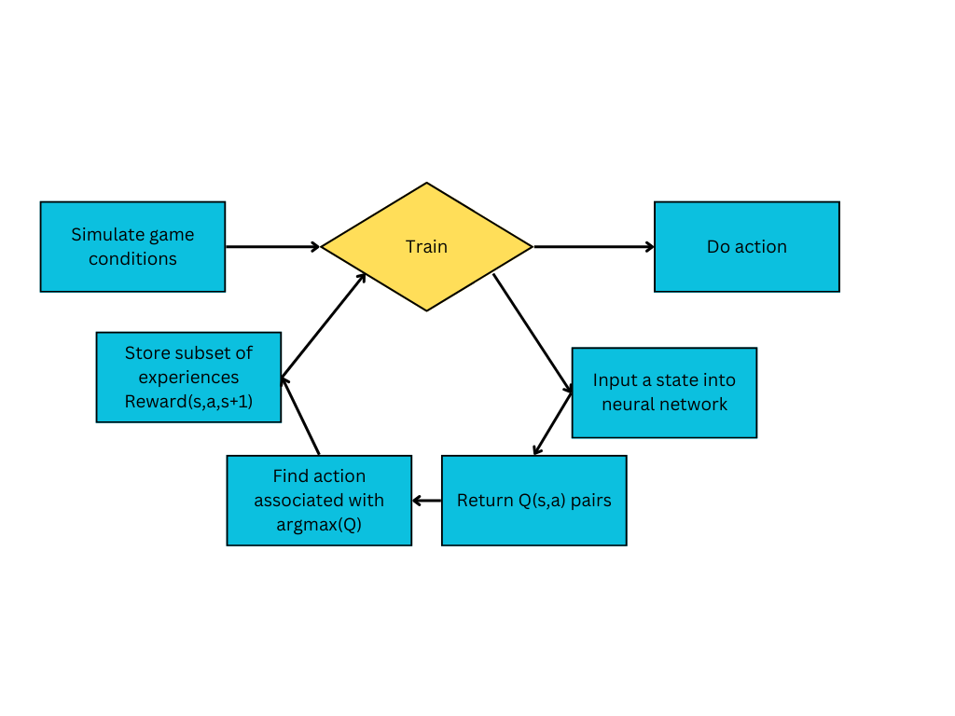
Reinforcement Learning – Our Machine Learning Paradigm
Reinforcement learning (RL) is a machine learning strategy motivated by the idea of reward and penalty. If the agent does an action with a good outcome, we reward it; likewise, we punish it if it acts badly. Gradually, the agent learns to perform rewarding actions and ignore penalizing ones.
Unlike supervised learning, RL typically doesn’t have a train/test/deploy distinction. Instead, it starts out as a “blank slate” with no learning history. As it experiments with possible actions, it converges on the most rewarding ones. Occasionally, it will experiment and try something completely random in order to avoid local minima (i.e., actions it THINKS are the best but aren’t ACTUALLY the best.)

Slide 11
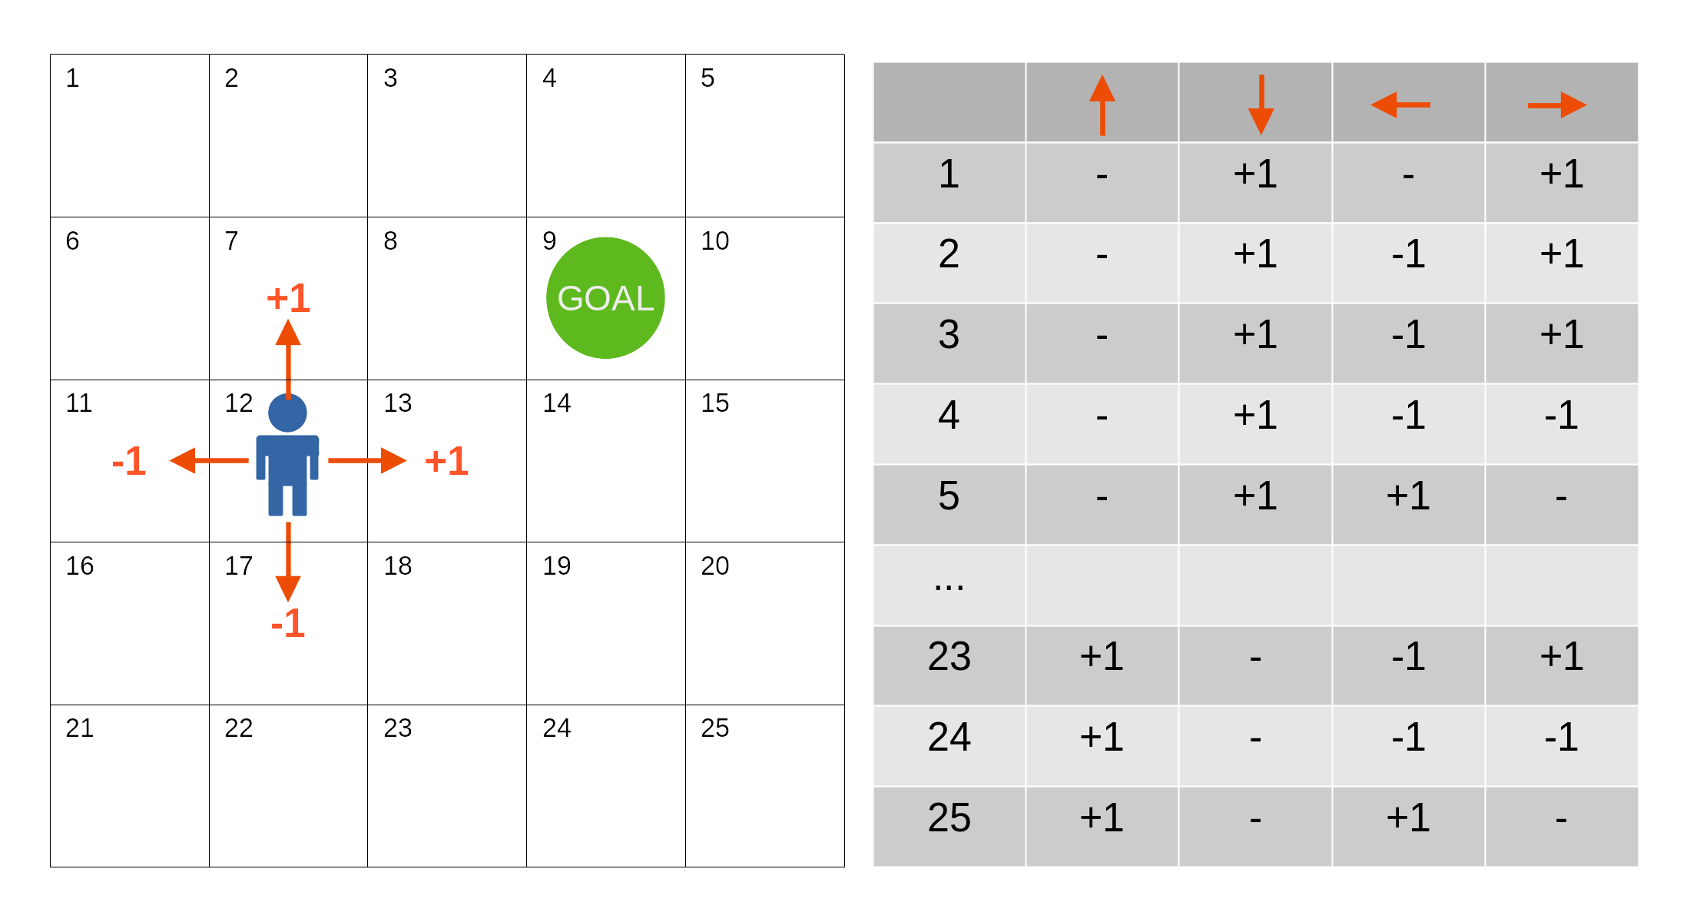
Deep Q-Learning – Our Reward Prediction Algorithm
Suppose we have a gamestate “s” and a possible action “a”. Q(s,a) represents the reward of that state-action pair. Usually, we’d find Q(s,a) by referring to its index in a Q-table, a giant memory bank of past experiences. But in a high state-space game like Spire, we need a deep Q-network (DQN) to help us get the Q value.
This is a traditional Q-learning setup. The game has 25 possible states n and 4 possible actions a. This Q-table has O(n*a) space complexity—it’s fine for 100 cells, but you can see how, as n approaches infinity, the table can’t work.
Shifting to deep Q-learning, we can process highly dimensional information without conceding on space complexity.
 | Card 1 | … | Card K
Gamestate 1 | R(1,1) |  | (1,K)
… |  | …
Gamestate K | (K,1) |  | R(K,K)
Random subset stored in memory buffer for future training
Input: a gamestate
Output: predicted reward for each action [a_1…a_k]
The DQN takes one input node for every element of the gamestate. My DQN has 3 fully-connected hidden layers with 3 nodes apiece – these haven’t been optimized, but seem appropriate for the complexity of a hand. It returns a vector of the estimated rewards of each action.
The DQN then does gradient descent against a loss retrieved from the memory buffer and arrives at reward minimum (what it thinks are the true values) for each action.
Credit: Spice.ai

Slide 12
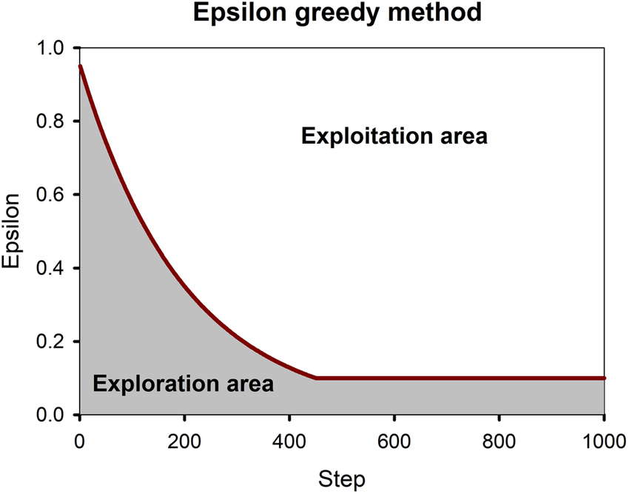
ε-greedy – Our Learning Algorithm
After running through the DQN, we have a vector [a1r, …, akr] of how well the DQN thinks each action will perform. Now we need to a) verify the actual reward of an action for storage, and b) continue the agent’s exploration. We do this using a strategy called ε-greedy.
Examples
act, rew | % to pick
1, 3 | 33%
2, 2 | 33%
3, -1 | 33%
Feedback from the ε-greedy strategy populates determines which action the agent actually takes, and by extension populates the memory buffer.
We never want the agent to stop experimenting, so ε never hits 0, but rather some arbitrary limit.
for ε ≈ 1.0
act, rew | % to pick
1, 3 | 99%
2, 2 | .5%
3, -1 | .5%
Rationale: we have a variable ε that represents the network’s “curiosity”. It starts off high then lowers (but never disappears) according to some rate. (image credit: ResearchGate)
for ε ≈ 0.0

Slide 13
Artifact
Bot
Agent

Slide 14
Methods
Game/Code interface: SpireComm by u:ForgottenArbiter on GitHub
Card Play Reward Setup
+ states:
+ Damage dealt
+ + + Powers played
+ + + + + + Enemy killed
+ + energy generated
+ + healed
- states:
- Damage taken
- - - - Death
Pathing | Drafting | Menus
NWH (Needs-Wants-Has) hardcoded approach using depth-first search. | NWH hardcoded with respect to deck archetype. (didn’t end up doing this, I don’t think it’s sound) | Low priority, basically just a bunch of if-else blocks.

Slide 15
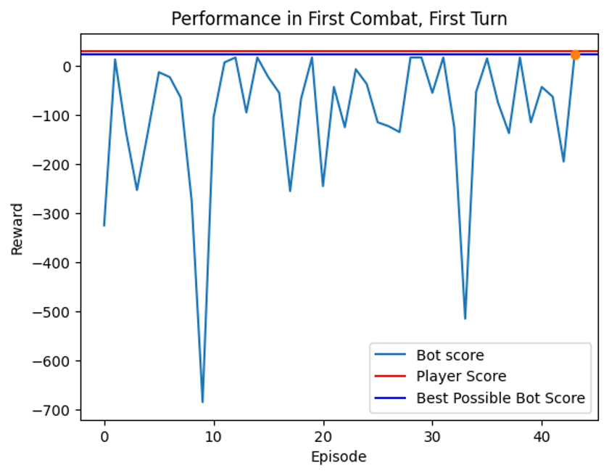
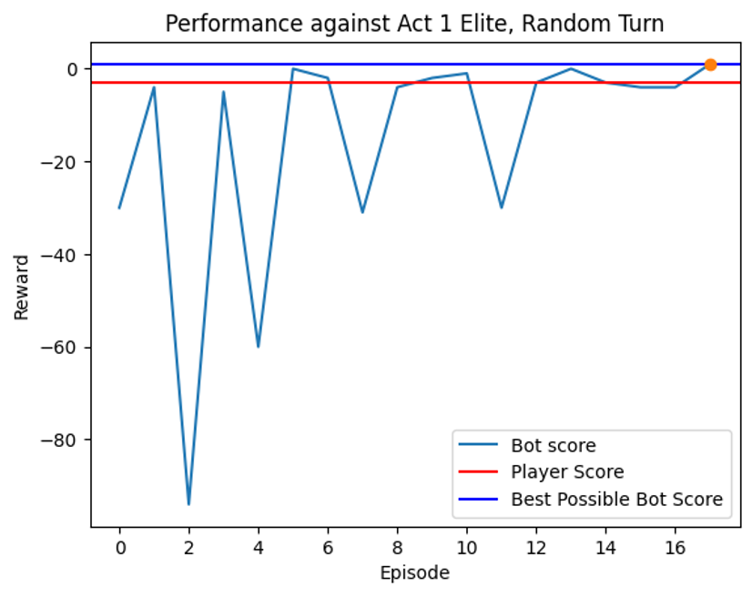
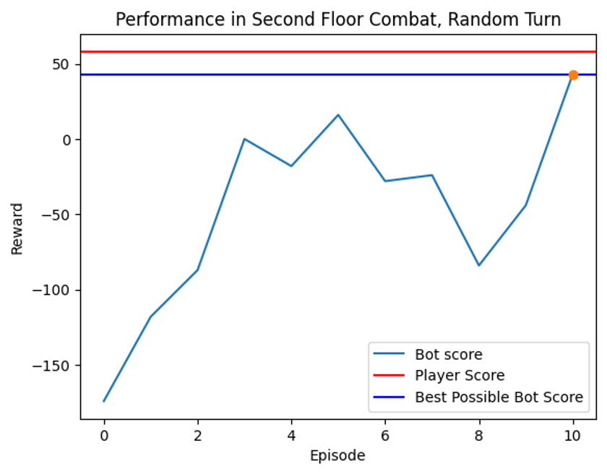
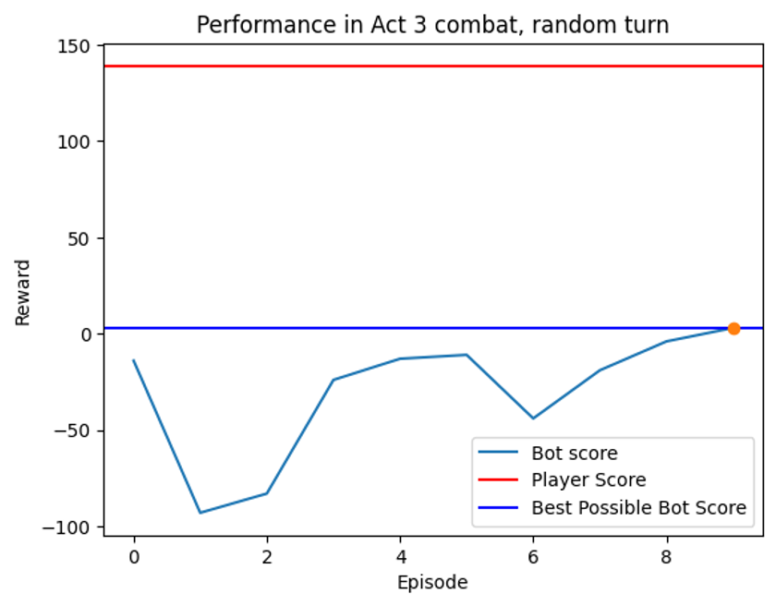
Results
Without exception* (in the 4 tested examples), the agent was able to find the best possible play order for a hand of cards, provided 100 epochs of learning time. Processing time per hand ranges from 5-20s depending on complexity.
* Act 3 combat example required draw, which is simulated poorly. If we seed it, it works 100% of the time, but otherwise it works ~75% of the time
Stipulations:
The global maximum under the simulation doesn’t necessarily reflect global maximum in-game (big problem).
I haven’t tested the agent with extremely complex (i.e., infinite) hands
I have only tested the agent with ~20 hands across 3 runs, all A0

Slide 16
Conclusion
Deep RL seems suited to finding the optimal card play order in StS, at least under this project’s constraints.
Future Improvements
Relevance
Need | Plan
Access to complete, true gamestate | Come up with some way to read Communications Mod’s output from console
Internal logic for simulating powers, etc. | Hardcode
Recognizing impossible actions | Action masking (dynamic updates of available actions)
Hyperparameter optimization | Empirical testing, for now
Replace heuristics with intelligent decision-making | Incorporate ML into pathing, drafting, menu navigation (ambitious)
RL is a new frontier of machine learning. Rather than imitate or predict behavior based on training data, it holds the potential to explore and innovate new approaches to old problems. My project pushes the corpus of RL research further into a high-randomness, high-state-space environment.
Beyond its relevance within the StS community, this project’s expansion into “roguelike” environments could move the needle for more broadly useful applications. Even in non-gameplay settings, RL problems are often framed as “games” to the agent – likewise, the same approaches agents take for actual games can be modified and applied to actual problems.

Slide 17
Thanks!

